Slide 1
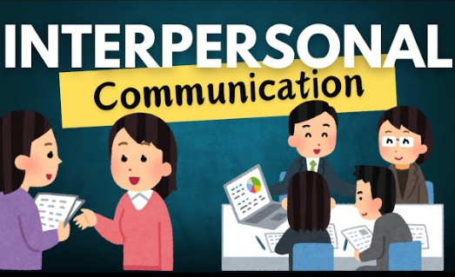

Slide 2
Interpersonal skills involve the ability to communicate and build relationships with others. Often called ‘people skills’, they tend to incorporate both your innate personality traits and how you have learned to handle certain social situations. Effective interpersonal skills can help you during the job interview process and can have a positive impact on your career advancement.

Slide 3
Interpersonal skills, often referred to as 'people skills', are crucial in every workplace as they aid in effective communication, building relationships and cooperating with others in a variety of scenarios.
These skills are highly transferable across industries and positions and include active listening, dependability, empathy, leadership, teamwork, among others, which greatly contribute to creating a positive work environment.
To improve your interpersonal skills, consider strategies such as attending workshops/online classes, seeking opportunities to build relationships, asking for constructive criticism, observing others' positive interactions and seeking mentorship.

Slide 4
Interpersonal communication skills are the abilities that enable someone to effectively interact and relate with others by conveying and understanding messages, both verbally and nonverbally. Key skills include active listening, clear expression of thoughts, empathy, nonverbal cue interpretation, teamwork, leadership, and conflict resolution, which are vital for building relationships and fostering productive environments in personal and professional settings

Slide 5
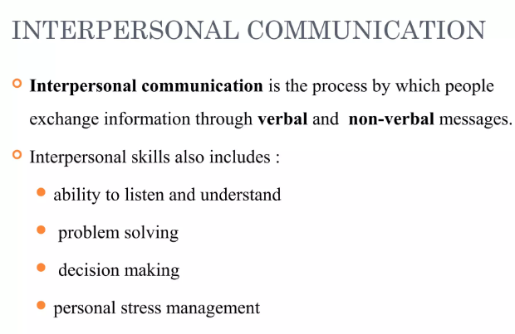

Slide 6
Different types of interpersonal communication
Interpersonal communication can be categorised into four main types. Below, we’ll briefly explain what each of these categories means:
Verbal. This is all about the words you’re actually saying and incorporates things like the language you choose, how persuasively you speak, and the use of affirmative sounds like “uh-huh” and “I see”.
Listening. Being able to listen attentively is one of the most important communication skills, whether you’re physically listening with your ears or being attentive in other ways. Listening can involve techniques such as clarification and reflection.

Slide 7
Different types of interpersonal communication
Written communication. It is becoming increasingly essential to have good written communication, whether you’re using it in the workplace or on social media. This incorporates things like clarity, tone, grammar, and even things like punctuation and emojis.
Non-verbal communication. As mentioned earlier, this includes everything that’s not being said in a face-to-face conversation. That’s gestures, body language, facial expressions and tone of voice. Being able to use these non-verbal cues and notice them in others can be useful.

Slide 8
Interpersonal communication examples
To give you an even broader understanding of these four different types of interpersonal communication, we’ve listed some examples underneath and revealed which category they fall under:
Phone calls. Since you can only hear voices during phone calls, you have to rely on strong verbal communication skills.
Presentations. You use all four types of interpersonal communication when presenting information. You need to speak clearly, use non-verbal cues, listen to your audience and refer to written texts.
Email. You need good written communication when writing emails, especially in the workplace.
Performing in a play. Performers need to use a mix of verbal and non-verbal communication to effectively entice the audience and get their message across.
Texting. This relies on written communication but is less formal than emails or letters and requires a more personalised approach.

Slide 9
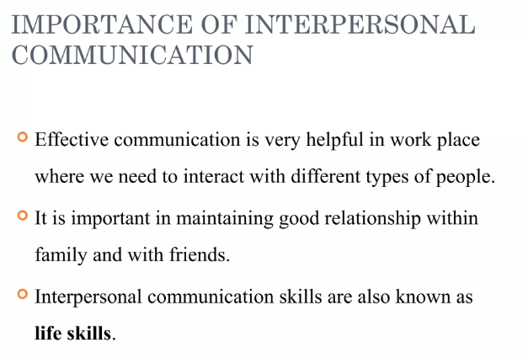

Slide 10
Interpersonal communication skills can improve your personal and professional relationships by helping you to express your thoughts and convey your intent clearly. Additionally, you’ll be more able to understand and empathise with others due to your listening skills.

Slide 11
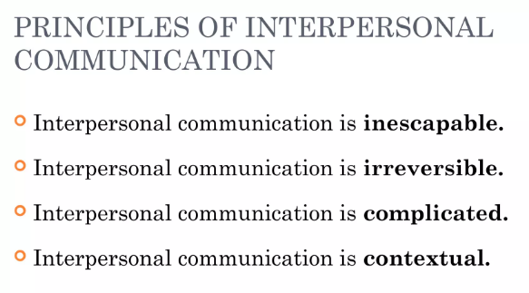

Slide 12
The Four Principles of Interpersonal Communication
There are four main principles to be aware of when considering interpersonal communication. These principles help to demonstrate the nature of interpersonal relations and should provide you with a deeper understanding.
Inescapable. It’s pretty much impossible to escape interacting with other people. Even if you prefer time by yourself, you’ll probably be communicating regularly online with others.
Irreversible. We can’t take back the things that we say or do during interactions with others. Even if we apologise or offer an explanation for what we did or said, our original communication can’t be reversed.

Slide 13
The Four Principles of Interpersonal Communication
Complicated. Because there are so many aspects of interpersonal communication beyond what is actually being said, it’s complicated by nature. Often, things can be interpreted in many different ways – and it can be especially hard for some neurodivergent people to pick up on subtle cues. Similarly, many neurotypical people are not aware of different communication styles, and this can also cause different interpretations.
Contextual. It can be difficult to control how our communications are received due to the other factors involved. Who is receiving the communication, where are they, and why have they perceived it a certain way? Most of this is down to context.

Slide 14
Key Aspects of Interpersonal Communication Skills
Verbal and Nonverbal Communication:
Interpersonal communication involves both speaking and listening, as well as understanding body language, eye contact, and other nonverbal cues to gauge the message being conveyed.
Relationship Building:
These skills are essential for initiating, building, and maintaining relationships with others.
Empathy and Emotional Intelligence:
Being able to understand and share the feelings of others is a core component of effective interpersonal communication.
Clarity and Conciseness:
The ability to express your thoughts, feelings, and intentions clearly helps prevent misunderstandings and ensures your message is received as intended.
Active Listening:
This goes beyond simply hearing; it involves actively engaging with the speaker to ensure full comprehension of their message and perspective.

Slide 15
Key Interpersonal Communication Skills
Teamwork
Empathy
Emotional Intelligence
Listening Skills
Time Management
Attitude
Responsibility

Slide 16
Potential barriers to interpersonal communication
A barrier to interpersonal communication is something that gets in the way of a message being received. This can lead to misunderstandings, disinterest and even offence.
1. Too much technical jargon
Unless you’re speaking to experts on the topic you’re talking about, you should try to avoid unnecessary jargon. This applies to verbal and written communication. Using too much unnecessarily technical language can make your message confusing or even incomprehensible, and the point that you’re making can get lost in translation. Instead, keep it clear and concise, paying attention to who you’re speaking to.
2. Inconsistent cues
Sometimes, you might be saying something with your words, but conveying something totally different with your body language. This is called an inconsistent cue because you’re sending two opposing signals simultaneously. For example, if you smile when you’re actually angry, the receiver will likely misunderstand the message you’re attempting to convey.

Slide 17
3. Choosing the wrong medium
Certain mediums are more appropriate than others for certain conversations. For example, emotional conversations are better to be had face to face, as you can use verbal and non-verbal cues to put across your message. Emails are great for conveying routine information, while texts or instant messages are good for casual conversations and quick questions.
4. Poor relationships
When there’s a lack of trust between people, particularly in a work environment, communication issues often arise. This is because preconceived notions of a relationship can affect certain messages being delivered effectively – maybe because the receiver isn’t paying proper attention, or because they don’t believe or respect what the speaker is saying. This can be exacerbated by things like cultural or generational differences, especially when people are holding on to stereotypes.

Slide 18
In addition to this, hierarchical structures in offices can also impede interpersonal communication, as junior employees may feel reluctant to communicate properly and present their opinions to their seniors.
5. External factors
There are often several uncontrollable external factors at play during interpersonal communication. Sometimes, this could be noise affecting hearing and focus, or it could be a poor internet connection impeding a conversation. Unfortunately, external factors will never go away, but it’s important to remember to be patient and considerate to the other person or people you’re communicating with when such difficulties arise.

Slide 19
How to Build Interpersonal Communication Skills
Building interpersonal communication skills can help you improve your relationships, increase your ability to collaborate effectively with others, and enhance your overall success in life. Here are some tips to help you develop them:
1. Practice Active Listening
One of the most important aspects of interpersonal communication is active listening. This involves fully concentrating on what the other person is saying, without interrupting or judging them. You can practice active listening by maintaining eye contact, nodding, and asking questions to clarify their message.
2. Use Clear and Concise Language
Communication is most effective when it is clear and concise. Use simple language and avoid jargon or technical terms that others may not understand.
3. Master Nonverbal Communication
Nonverbal communication, such as body language and facial expressions, can also convey messages. Be aware of your own nonverbal cues and try to read others' body language to better understand their message.

Slide 20
How to Build Interpersonal Communication Skills
4. Show Empathy
Empathy involves understanding and sharing the feelings of others. When communicating with others, try to put yourself in their shoes and show understanding and compassion for their perspective.
5. Build Rapport
Building rapport involves finding common ground and establishing a connection with others. This can help to build trust and enhance communication. Look for common interests or experiences, and use humor or other forms of positive reinforcement to build a positive relationship.
6. Be Open to Feedback
Be open to constructive criticism and feedback from others, and use it as an opportunity to learn and grow.

